Slide 2
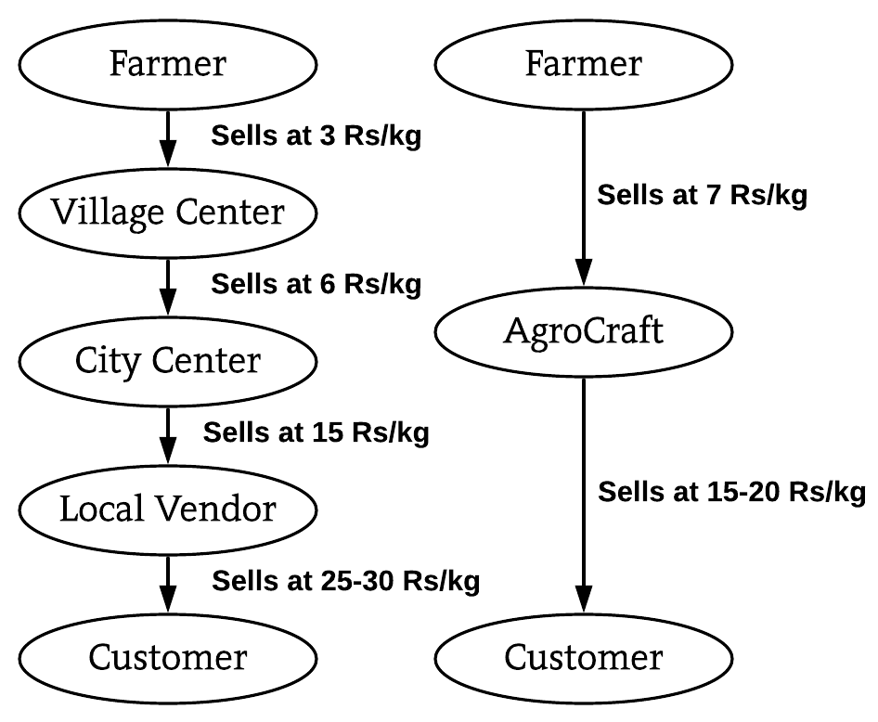
SOLUTION PROTOTYPE
Multilingual SMS and Call System for illiterate farmers to insert/edit/upload products & Multilingual portal also available.
Minimum selling price will be made visible to farmers for rough estimate to enter price of product.
Buyer can order from all over India, so if scarcity of a product arises, the buyer will be suggested of locations near to him, where the product is available.
Filter system(filter by price and location).
Review system & Reporting system(verification team will respond, guilty farmer will be penalised and buyer, compensated.
Bestseller feature.
Subscription feature. (Order once, product will be delivered for the specified duration). Government warehouses available for storage.
Bookmark system (buyer prefers a farmer, he will be notified every time the farmer uploads).
For packaging & delivery, local transportation services, courier services and Indian postal(rural areas covered) will be integrated.
Conventional v/s AgroCraft
TECHNOLOGY STACK
Web Technology : HTML, CSS, JavaScript, AJAX, Bootstrap , Django and nodeJS .
Programming languages : - Python.
Mobile Development :-Android Studio, Android SDK and Jellybean version and above.
Backend Development : -MySQL Database and Firebase.
Modern Technology :- Big Data , Data Analytics , Visualization, Machine learning .

